Slide 1
the description of the picture «Ivan Tsarevich on the Grey Wolf»
Viktor Vasnetsov
Prepared:
Lezin Maksim

Slide 2
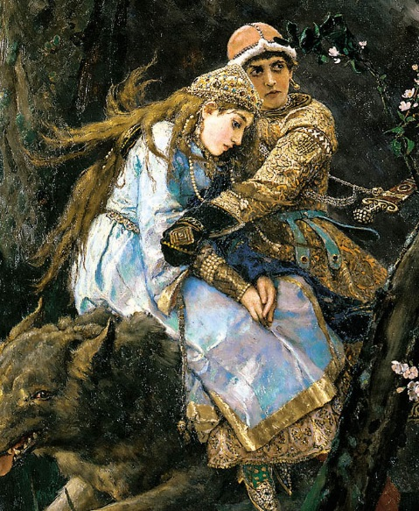

Slide 3
The famous Russian artist Viktor Vasnetsov created his numerous paintings based on Russian folk tales.
The painting «Ivan Tsarevich on the Grey Wolf», was painted by Viktor Vasnetsov in 1889. The plot was inspired by a Russian folk tale about a brave hero and his faithful servant. Through the dense forest, Ivan Tsarevich and Elena the Beautiful are gallopping on the Grey Wolf.
Hugging his bride, Ivan Tsarevich is attentively staring ahead. He is wearing a golden coat and a red hat. Elena the Beautiful is dressed in a long blue sundress. She is trustingly pressing to the breast of her savior.
The huge Gray Wolf is quickly rushing forward. With his his strong paws he is jumping over the swamp with white lilies. Dark colors of this picture cause the feeling of anxiety, and only the blossoming apple-tree with its beautiful white flowers gives hope for a happy ending.

